Slide 1



AWS Foundation
Introduction to VPC
Notes:
Welcome back to the forth module of data science.

Slide 2
Agenda
1
WHAT IS AMAZON VPC
6
SECURITY IN VPC
11
VPC ENDPOINTS
2
IP ADDRESS AND CIDR NOTATIONS
7
DEMO 3: SECURITY
12
VPC PRICING
3
8
13
DESIGN PATTERNS
DEMO 1: VPC
TYPES OF VPC
4
COMPONENTS OF VPC
9
14
SUBNETS
SUMMARY
5
DEMO 2: NAT GATEWAY
10
15
QUIZ
VPC PEERING

Slide 3
What is Amazon VPC

Slide 4




What is Amazon VPC
Virtual Private Cloud
Amazon VPC – Lets you create a logically isolated section of the AWS cloud where you can launch AWS services in the Virtual Network which you defined.
VPCs span all Availability Zones in a Region
Region
AZ-1
AZ-2
AZ-3

Slide 5


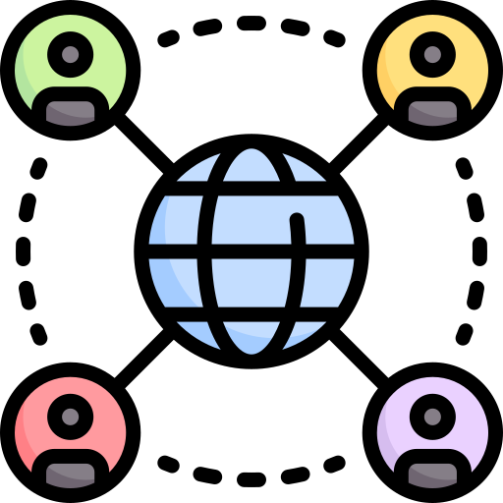



What is Amazon VPC
Instances
Subnet
VPC
Public Network
Branch Office
Internet Gateway
Customer Gateway

Slide 6
IP Address and CIDR
Notations

Slide 7
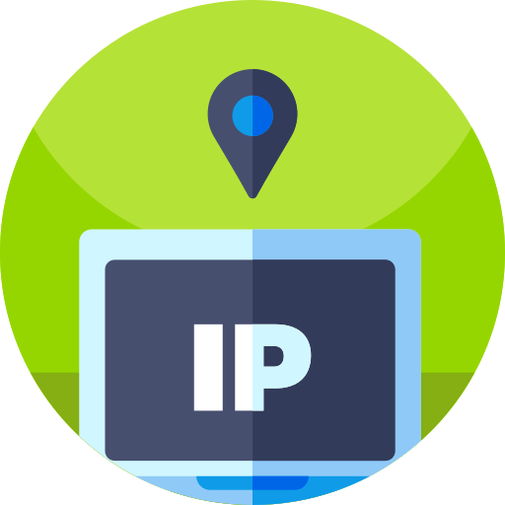

IP Addressing
What is an IP Address?
A Sample IP Address
Unique string of numbers assigned to a computer using the Internet Protocol to communicate over a network
54.92.31.18
54
92
31
18
54.92.31.18
Decimal Values
0011 0110
0101 1100
0001 1111
0001 0010

Slide 8
IP Addressing
Network Address = 54.92.X.X
Host Number = X.X.31.18
Network Address = 54.92.0.0/16
CIDR = Classless Inter Domain Routing
2^16 – 1
(65535)
So, Number of Hosts =
54.92.0.0
to
54.92.255.255

Slide 9
IP address range for CIDR
Range of IP addresses for Network Address 54.92.0.0/16:
1111 1111
1111 1111
0000 0000
0000 0000
54
92
0000 0000
0000 0000
54.92.0.0
54.92.0.1
54
92
1111 1111
1111 1111
54.92.255.255
54.92.255.254
Range of IP addresses for Network Address 54.92.0.0/20:
1111 1111
1111 1111
1111
0000
0000 0000
54
92
0000
0000
0000 0000
54.92.0.0
54.92.0.1
54
92
0000
1111
1111 1111
54.92.15.255
54.92.15.254

Slide 10
CIDR Classes
Class A
Class B
Class C
X.0.0.0/8
X.X.0.0/16
X.X.X.0/24

Slide 11
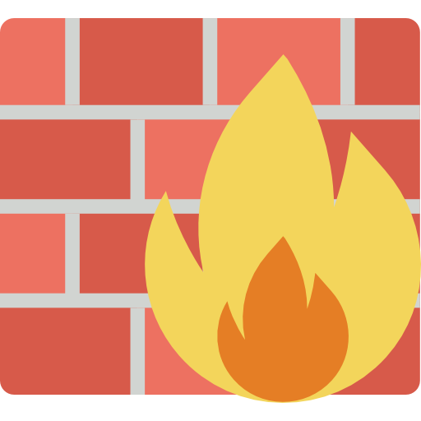
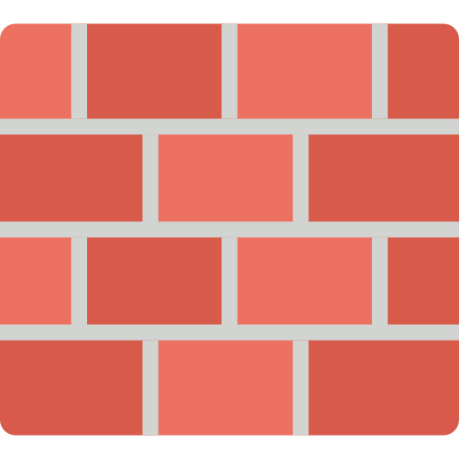




Firewall
Firewall is a system made to prevent unauthorized traffic to and from your PRIVATE network/computer/server by Allowing or Denying those traffic.
Allowing and denying traffic are mentioned by Rules, also called firewall rules.
Inbound Request
Outbound Request
Outbound Response
Inbound Response

Slide 12
Firewall
Types
Stateful: No additional rules are needed for response traffic.
Stateless: Rules have to be mentioned for both request and response.
IN
OUT

Slide 13
Demo 1: VPC

Slide 14
Demo 1: VPC
Creating VPC and Subnets
Create VPC with CIDR block 24.8.0.0/20 (myVPC) in the Region N. Virginia.
Create 3 subnets in the VPC created above. All 3 subnets should be in different Availability Zones.
  myVPC-subnet-1A
  myVPC-subnet-1B
  myVPC-subnet-1C
myVPC-subnet-1A should be PUBLIC subnet. myVPC-subnet-1B, myVPC-subnet-1C should be PRIVATE subnets.
Launch two EC2 instances in each of the subnets 1A and 1B created above.
Launch one instance in the subnet 1C.

Slide 15
Components of VPC

Slide 16
Components of VPC
Network Interfaces
Route Tables
Internet Gateway
Network Address Translation (NAT)
Security – (Security Groups and NACL)

Slide 17
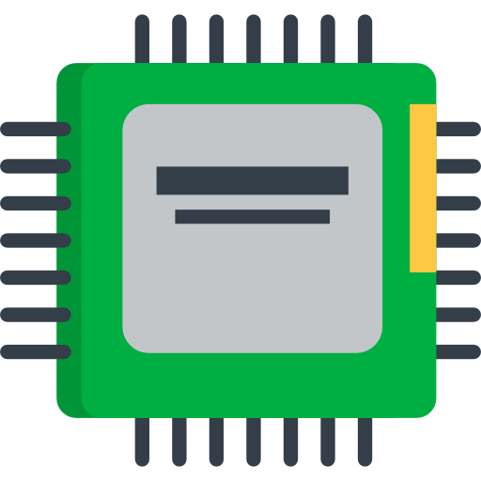

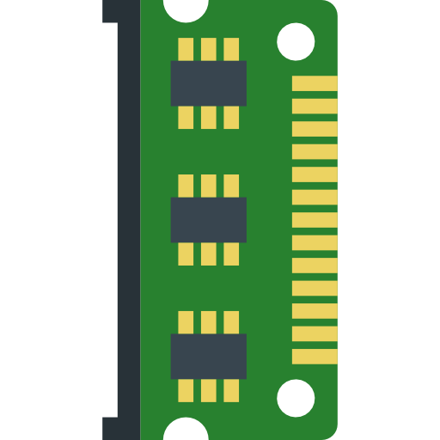


Network Interfaces
Network Interface
  Interface between a computer and an internet network.
  Network IO happens via N/W interface cards
  N/W interfaces contain – Elastic IP, Public IP, Private IP, Security Groups
CPU
N/W Interface Card
Internet N/W
RAM
Motherboard
Elastic IP

Slide 18
Network Interfaces
Elastic Network Interface – It is a Virtual Network Interface and it contains all of the attribute below
Private IP
Elastic IP
Public IP
N/W Interface Card
Source/Destination Check
MAC address
Security Groups

Slide 19

Network Interfaces
Elastic Network Interface
Network interface can be:
Created to an Instance
Attached to an Instance
Detached from an Instance
Re-attached to another instance.
EC2
Instance 1
EC2
Instance 2
Private IP
Elastic IP
Public IP
Security Group
MAC address
Source/Dest check

Slide 20
Network Interfaces
Multiple IP Addresses
Network interface can have an additional Secondary IP address attached to it.
IP address can be assigned to n/w interfaces attached to a running or stopped instance.
EC2 Instances
Public Subnet
Private Subnet

Slide 21



Route Tables
Route table tells a machine/network where traffic is directed.
Directions are defined by “routes” in Route Tables.
Each subnet must be associated with a Route.
All VPCs come with an implicit router and a main route table which can be modified.
Subnet 1
(Public)
1.1.2.3
5.8.13.21
Subnet 2
(Private)
ec2 inst1
ec2 inst2
Destination | Target
5.8.13.21 | Local
0.0.0.0/0 | IGW
6.4.2.1/32 | IGW
IGW
Longest Prefix Match
Internet

Slide 22
Internet Gateways
An internet gateway is a horizontally scaled, redundant, and highly available VPC component that allows communication between instances in your VPC and the internet
Internet
Purpose of an Internet Gateway
Created to an Instance
Attached to an Instance
Detached from an Instance
Re-attached to another instance.
Internet Gateway
Link
Route table
EC2 instances
EC2 instances
Subnet
Subnet
Availability Zone 1
Availability Zone 2

Slide 23
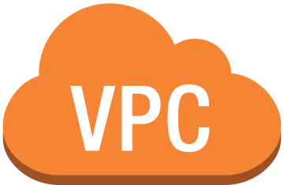

Network Address Translation
Internet cannot initiate any connection to the instances via NAT.
NAT devices enable instances in the Private Subnet to connect to Internet and brings responses back to the instances.
NAT devices are created in Public Subnet.
10.20.1.0/24
Internet
ec2 instances
NGW
IGW
Destination | Target
10.20.1.0/24 | Local
0.0.0.0/0 | NAT gateway
Subnet 1A (Public)
Availability Zone 1
ec2 instances
Subnet 2A (Private)
Availability Zone 2

Slide 24
Network Address Translation
NAT Gateway vs NAT Instance
NAT Gateway | NAT Instance
Implemented with redundancy. | Failover has to be managed manually using scripts.
Supports Burst up to 10 Gbps. | Depends on the bandwidth of the instance type.
Entirely managed by AWS. | Has to be managed by the customer.
No size. | Instance type and size can be selected.
Only NACLs can be used to filter traffic. | Both Security Groups and NACLs can be used.
Elastic IP has to be associated. | Both Elastic IP and Public IP can be used.

Slide 25
Demo 2: NAT Gateway

Slide 26
Demo 2: NAT Gateway
SG and NACL – 3 Tier Architecture
Use the public and private subnet which was created in the previous demo.
Spin up 1 instance each on public and private subnets – “pub” and “priv”.
Setup NACLs to control traffic. “pub” should be able to ssh to “priv”.
Try to install “httpd” service using command “sudo yum install -y httpd”.
Create and attach a NAT gateway to pubic subnet.
Modify route tables and N/W ACL rules to allow “priv” to install httpd from internet.
Attach a public IP to “priv”.
Try to ssh to priv from local machine. Failure shows that NAT does not allow request from internet to go into instances in private subnet.

Slide 27
Security in VPC

Slide 28
Security
Security Groups
A security group acts as a virtual firewall for your instance to control inbound and outbound traffic
SSH request
1.1.2.3
5.8.13.21
SSH response
EC2 inst1
EC2 inst2
Type | Protocol | Port | Destination
SSH | TCP | 22 | 5.8.13.21
TO 5.8.13.21
Outbound
EC2 inst1
Type | Protocol | Port | Source
SSH | TCP | 22 | 1.1.2.3
FROM 1.1.2.3
Inbound
EC2 inst2

Slide 29
Security
Network ACLs
ssh
1.1.2.3
5.8.13.21
ssh
ec2 inst1
ec2 inst2
Subnet 1
1.1.2.0/24
Subnet 2
5.8.13/24
subnet1 | Rule No. | Type | Protocol | Port | Destination | Allow/Deny
Outbound | 100 | SSH | TCP | 22 | 5.8.13.0/24 | ALLOW
Outbound | 200 | ALL Traffic | ALL | ALL | 0.0.0.0/0 | DENY
Network Access Control Lists
Optional layer of security for your VPC that acts as a firewall
Controls traffic in and out of one or more subnets
subnet1 | Rule No. | Type | Protocol | Port | Source | Allow/Deny
Inbound | 50 | ALL Traffic | ALL | ALL | 0.0.0.0/0 | DENY
Inbound | 100 | SSH | TCP | 1024-65535 | 5.8.13.0/24 | ALLOW
subnet1 | Rule No. | Type | Protocol | Port | Source | Allow/Deny
Inbound | 100 | SSH | TCP | 1024-65535 | 5.8.13.0/24 | ALLOW
Inbound | 200 | ALL Traffic | ALL | ALL | 0.0.0.0/0 | DENY

Slide 30
Security
Network ACLs
1.1.2.3
ssh
5.8.13.21
ssh
ec2 inst1
ec2 inst2
Subnet 1
Subnet 2
Type – inst1 | Rule No. | Type | Protocol | Port | Source | Allow/Deny
Inbound | 100 | SSH | TCP | 22 | 1.1.2.0/24 | ALLOW
Inbound | 200 | ALL Traffic | ALL | ALL | 0.0.0.0/0 | DENY
Type – inst1 | Rule No. | Type | Protocol | Port | Destination | Allow/Deny
Outbound | 100 | SSH | TCP | 1024-65535 | 1.1.2.0/24 | ALLOW
Outbound | 200 | ALL Traffic | ALL | ALL | 0.0.0.0/0 | DENY

Slide 31
Demo 3: Security

Slide 32
Demo 3: Security
SG and NACL – 3 Tier Architecture
Create a VPC – “3tier-architecture” with CIDR 10.20.0.0/16. Create 3 subnets – 1 public - web and 2 private – app and db.
Launch “web1” and “web2” instances in Subnet “web”.
Launch “app1” and “app2” in Subnet “app”.
Launch “db1” in Subnet “db”.
“web1” and “web2” are basic httpd web servers and should be connectable from internet on ports 22 (SSH) and 80 (HTTP). Test it.
“app1” and “app2” should only be connectable from “web1” and “web2” using Private IP addresses over port 22 (SSH).
“db1” should be connectable only from “app1” and “app2” using Private IP address over port 22 (SSH).

Slide 33
Types of VPC

Slide 34
Types of VPC
Default and Non-default VPC
  EC2-VPC platform only - it comes with a default VPC that has a default subnet in each Availability Zone
  A default VPC has the benefits of the advanced features provided by EC2-VPC, and is ready for you to use
  Regardless of which platforms your account supports, you can create your own VPC, and configure it as you need
  Subnets created here are called as non-default subnets
Default VPC
Non-default VPC

Slide 35
Subnets

Slide 36
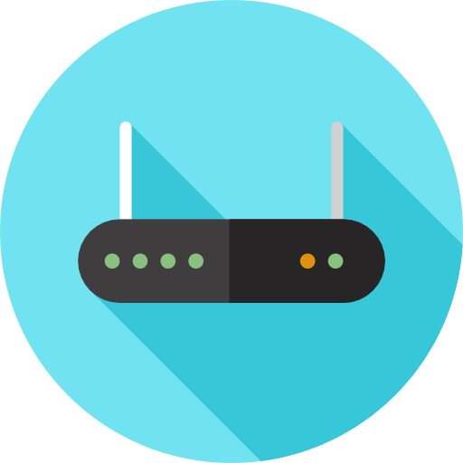

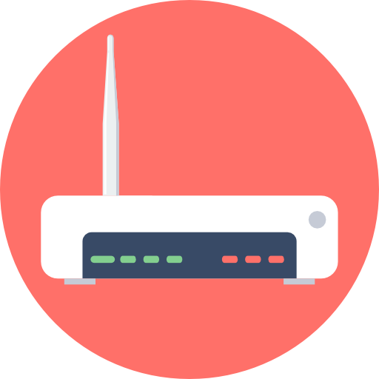


Subnets
Subnet is dividing a large network into multiple smaller logical networks.
Each subnet is a separate network on its own. Machines in one subnet cannot talk to machines in other subnet directly. Route through the main router has to be taken.
Subnet 1
52.26.10.0/24
Main Router
52.26.0.0/16
Subnet 2
52.26.20.0/24

Slide 37
Subnets
Public Subnet has internet gateway associated with it.
Private subnet does not have any route to Internet Gateway.
Internet
Public Subnet
Private Subnet
Internet Gateway
Subnet
ec2 instances
ec2 instances
Availability Zone

Slide 38
Demo 4: VPC Architecture

Slide 39
Demo 4: Architecture
Internet
pub
NGW
IGW
Public Subnet
Availability Zone 1A
priv
Private Subnet
Availability Zone 1B

Slide 40
VPC Peering

Slide 41


VPC Peering
VPC Peering
Network connection between two VPCs which enables traffic flow between them using Private IP addresses.
Peering connections can be created between VPCs in the same or different accounts and between VPCs in the same or different regions.
VPC Peering

Slide 42
VPC Peering
p1-1a-pub
p2-2a-pub
vpc-peer1-subnet1a-pub
vpc-peer2-subnet2a-pub
VPC Peering
p1-1a-priv
p2-2a-priv
vpc-peer1-subnet-1b-priv
vpc-peer2-subnet-2b-priv
vpc-peer1
vpc-peer2

Slide 43
VPC Peering
SSH
p1-1a-pub
p2-2a-pub
vpc-peer1-subnet1a-pub
vpc-peer2-subnet2a-pub
VPC Peering
p1-1a-priv
p2-2a-priv
vpc-peer1-subnet-1b-priv
vpc-peer2-subnet-2b-priv
vpc-peer1
vpc-peer2

Slide 44
VPC Peering
SSH
p1-1a-pub
p2-2a-pub
vpc-peer1-subnet1a-pub
vpc-peer2-subnet2a-pub
VPC Peering
p1-1a-priv
p2-2a-priv
vpc-peer1-subnet-1b-priv
vpc-peer2-subnet-2b-priv
vpc-peer1
vpc-peer2

Slide 45
VPC Peering
VPC Peering
2
11.22.0.0/16
1
4
10.20.0.0/16
25.50.0.0/16
3
11.22.0.0/16

Slide 46
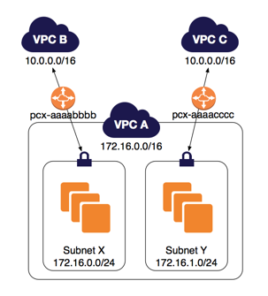
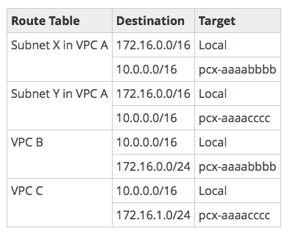
VPC Peering
VPC Peering Scenarios
Two VPCs (with same n/w address) peered with 2 subnets in the same VPC.

Slide 47
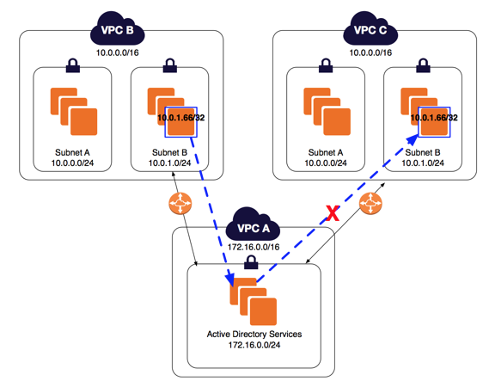
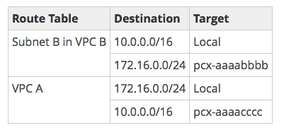
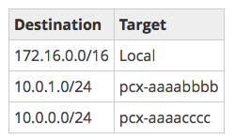
VPC Peering
VPC Peering Scenarios
Two VPCs peered with specific subnets.

Slide 48
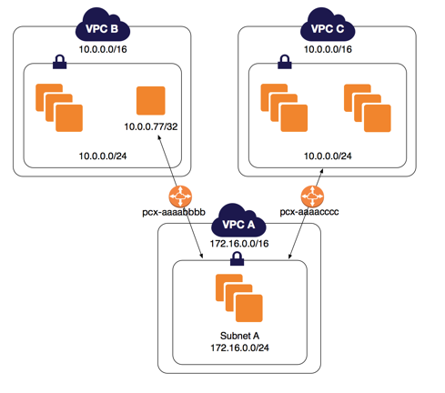
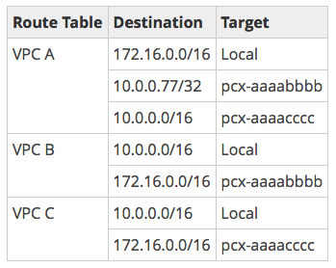
VPC Peering
VPC Peering Scenarios
One VPC peered with two VPCs using Longest Prefix Match.

Slide 49





VPC Endpoints
Gateway Endpoint.
Interface Endpoint – Powered by PrivateLink.
Destination | Target
10.20.0.0/16 | local
Destination | Target
10.20.0.0/16 | local
To S3 | vpce-id

Slide 50
VPC Pricing

Slide 51
VPC Pricing (us-east-1)
Free tier: Entirely free except for VPN and NAT Gateway.
Only VPN connection and NAT Gateway are priced.
VPN: $0.05 per VPN connection per hour.
NAT Gateway: $0.045 per hour, $0.045 per GB of data processed per hour.
Visit https://aws.amazon.com/vpc/pricing/ for details.

Slide 52
VPC Pricing (us-east-1)
Data Transfer OUT:
From EC2 To
S3 in same region = FREE
EC2, ENI in different AZ = $0.010/GB.
NGW
Internet
IGW
NAT GTW running price (monthly) = $0.045*24*30 = $32.4
Data Transfer out to S3 = $0
NAT GTW data processing price for 200 GB = $0.045*200 = $9.0
Data Transfer out to NAT = 200*$0.010 = $2.0
Total Price = 32.4 + 9 + 2 = $43.4/month

Slide 53
Design Patterns

Slide 54



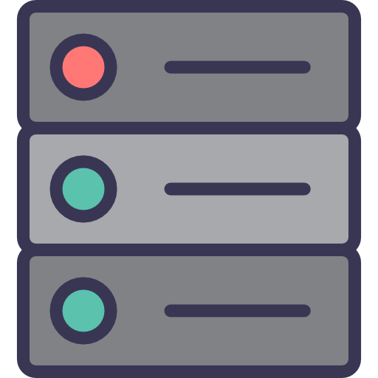
Design Patterns
Transit VPC
vpc-1
vpc-3
ap-south-1 (Mumbai) region
vpc-2
Transit VPC
us-east-1 (N. Virginia) region
Data Center

Slide 55
Design Patterns
Multi-region VPC connectivity
EC2 instances with software VPN configured using something like OpenSwan
VPN Connection
Public Subnet
Public Subnet
us-east-1 (N. Virginia) region
ap-south-1 (Mumbai) region

Slide 56
Summary

Slide 57
Summary
IP addresses and CIDR notation
Firewall
Components of VPC
VPC Peering and VPC Endpoints
VPC pricing and Design Patterns

Slide 58
Quiz

Slide 59
Quiz
1. What functions of an AWS VPC is stateless?
A. Security Group
B. Network Access Control Lists
C. AWS Firewall
D. Peering No

Slide 60
Quiz
2. Newly Created subnet in Default VPC is called?
A. Default Subnet
B. Non Default Subnet
C. Subnet
D. Default VPC

Slide 61
Quiz
3. Security Group operates at which layer?
A. VPC
B. Account
C. Subnet
D. Instance

Slide 62
Quiz
4. How many subnets are allowed per VPC?
A. 500
B. 200
C. 100
D. No Limitation

Slide 63
Quiz
5. ACL evaluates the rules starting with the highest numbered rule.
A. True
B. False

Slide 64
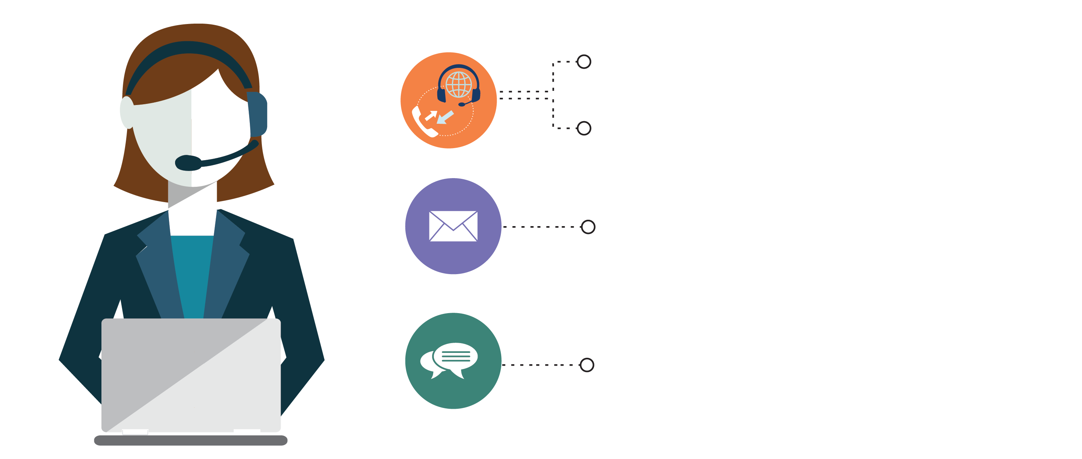
India : +91-7847955955
US : 1-800-216-8930 (TOLL FREE)
support@intellipaat.com
24X7 Chat with our Course Advisor
Notes:
Thank you!

